Slide 1

Lariat Rental Cars
The Goal is Higher Profits
Notes:
Welcome to my presentation, we will be discussing a few strategies for increasing profits.

Slide 2
Our Strategies
1. Rely on growth in business.
2. Replace poorly performing vehicles with more of the best performing ones.
3. Purchase new 2019 models based on popularity.
Notes:
Here we can see the three business strategies that we will go over: New revenue, different cars, and new cars. We will compare their results and later combine their effects.

Slide 3
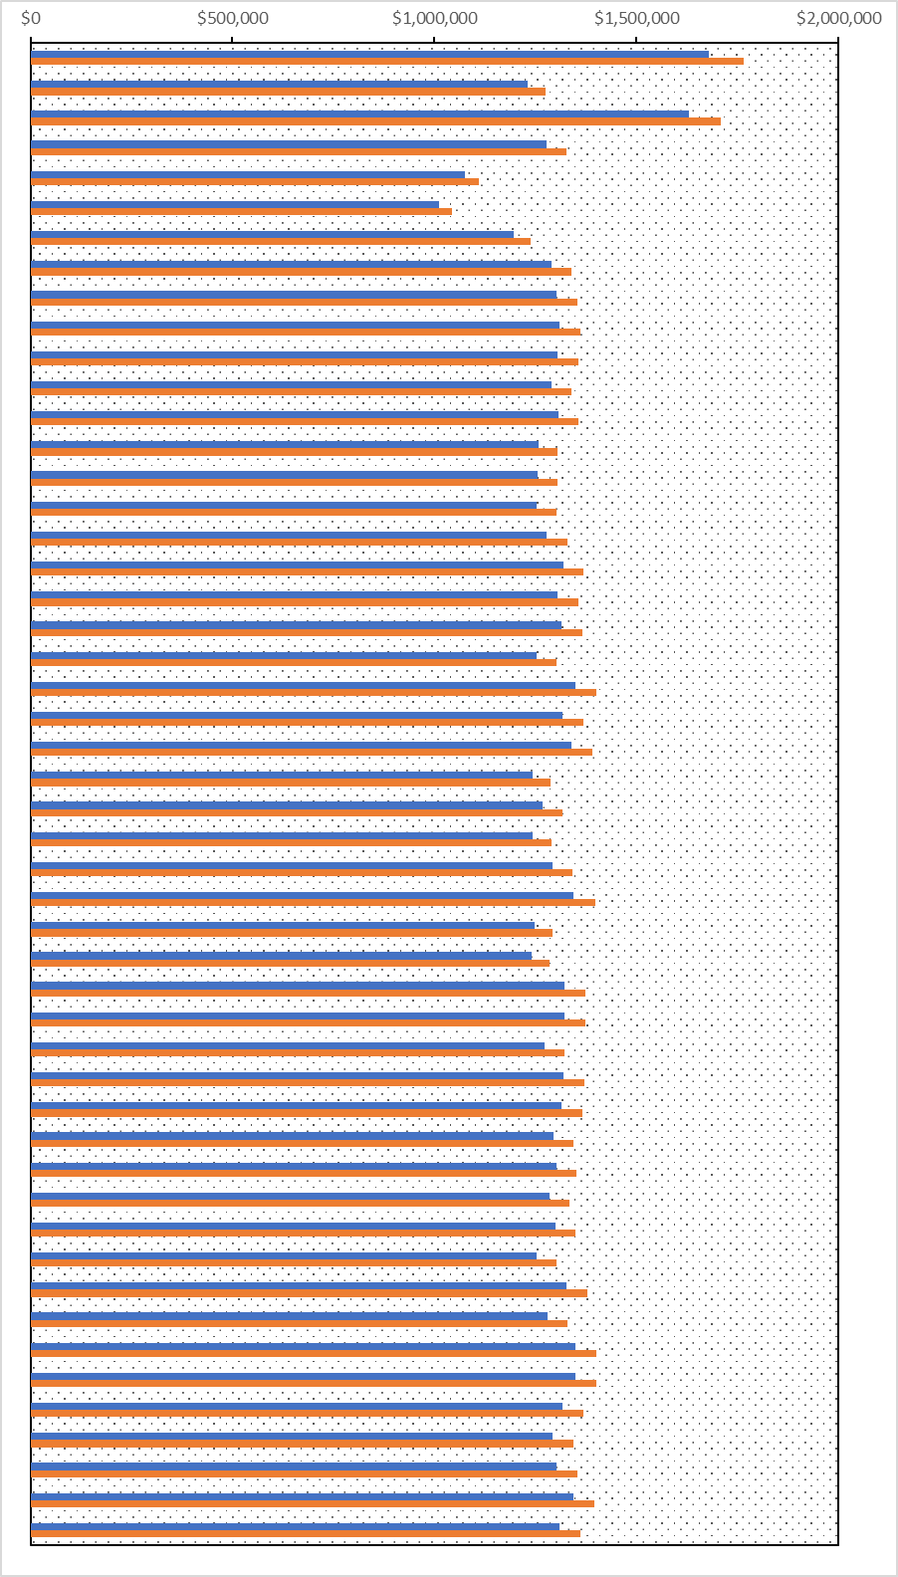

Growth in Business
Branch 1 increases over $85,0000 (5.1%)
Branch 6 only about $30,350 (3%)
1
6
50
Measured in Gross Revenue
Notes:
Here we can see the projected growth in revenue for all 50 branches. The growth rate is determined uniquely for each branch based on their 2018 revenues. The maximum and minimum are the branches being brought to attention.

Slide 4


Totals
Total Revenue 2018: $64,866,040
Average Increase per Branch Total Increase
$50,537 $2,526,849
The Average Growth is 3.9%
Total Revenue 2019: $67,392,889
Notes:
This summarizes the effects of our first strategy.

Slide 5
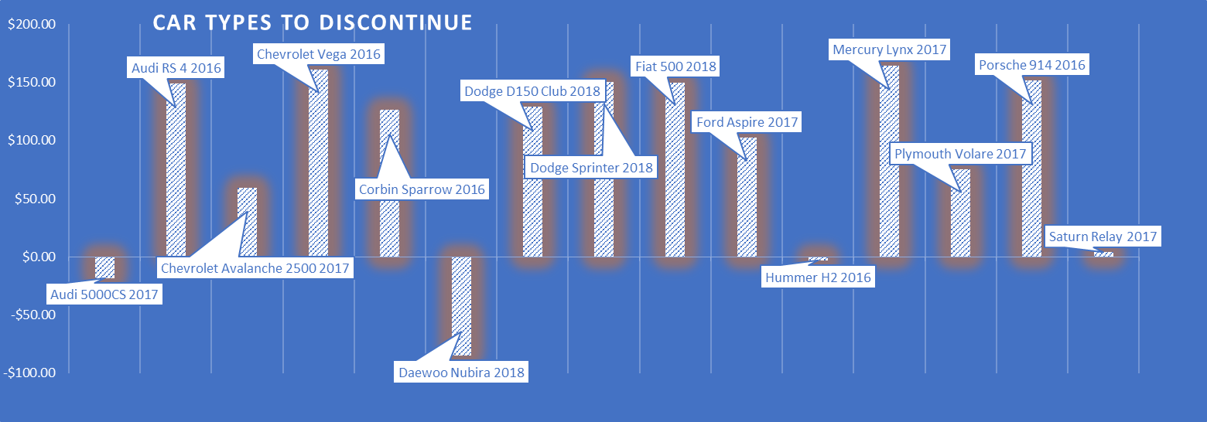
Get rid of the Bad Cars
Average profit per rental.
Notes:
While analyzing the data I received from Lariat, I Identified 15 with terrible average profit per rental. The strategy here is to discontinue these cars.

Slide 6
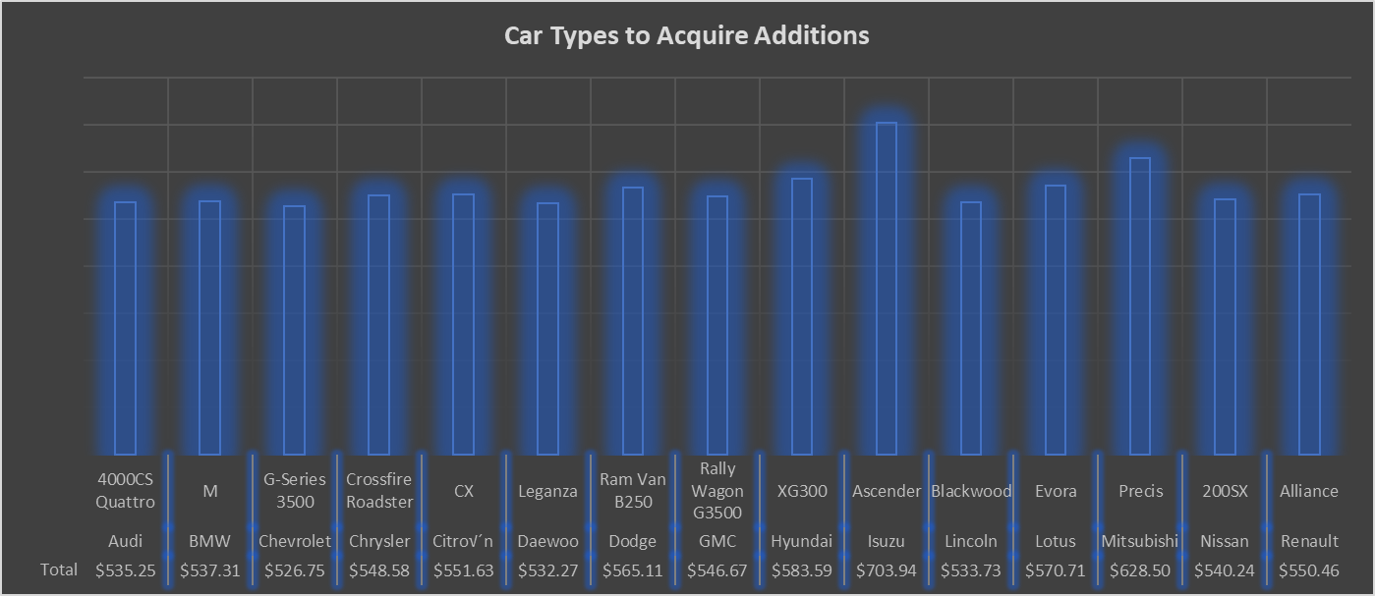
Acquire More of the Good Cars
Average
Profit per
rental
Notes:
Also during my analysis, I identified 15 cars that displayed excellent averages of profit per rental. The strategy here is to get one more of each.

Slide 7
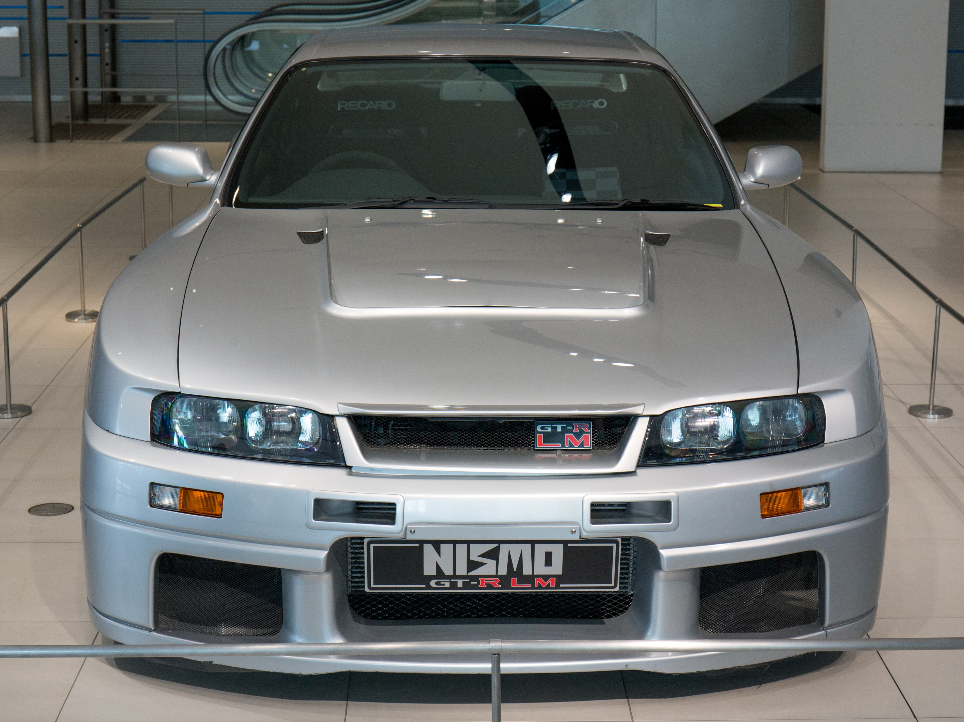
Totals
2018 Profit: $36,383,335.89
Exchanging these cars:
Decreased Costs over $30,000
Increased Revenue over $185,000
Profit Increased $215,623.25
2019 Profit: $36,598,959.14
This Photo by Unknown Author is licensed under CC BY-SA
Notes:
This summarizes the effect of our second strategy. It is important to note that we can take this idea further, not stopping at trading out 15 cars. The purpose of this was just to demonstrate the idea and how it affected profit. That’s my dream car, by the way.

Slide 8
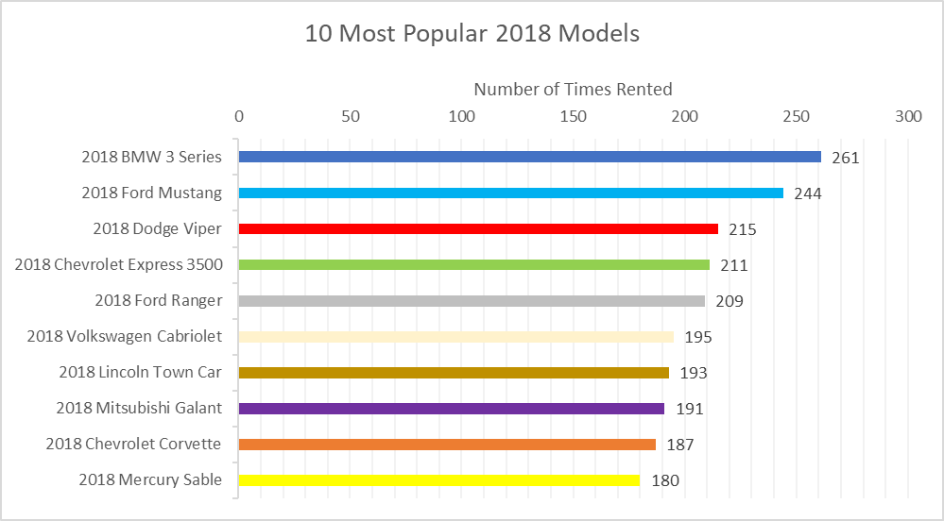
Give them What they Want!
Notes:
I identified these 10 cars through my analysis that were rented the most overall. The strategy here is for Lariat to purchase 5 2019 models of each of them.

Slide 9
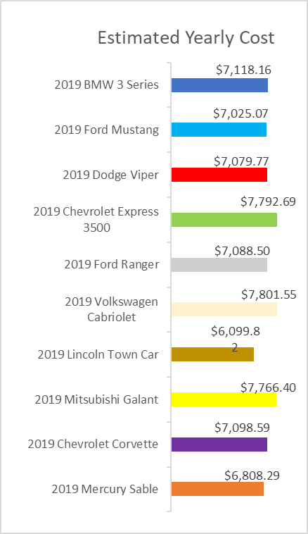
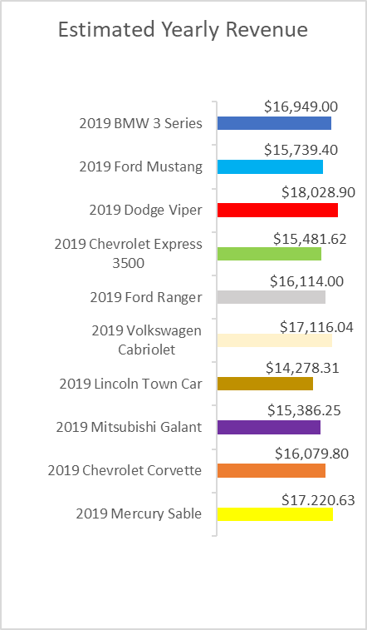
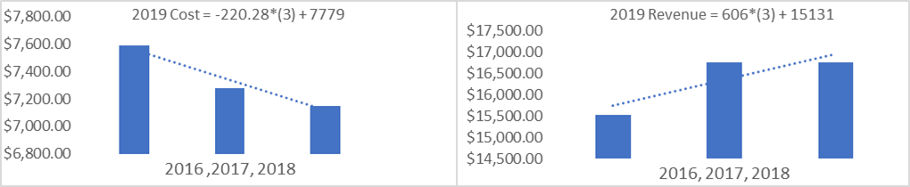
Cost and Revenue
BMW 3 Series
Notes:
Using linear approximation, I estimated the annual costs and revenues of the 2019 models. The example BMW here showed a downward trend in cost and an upper trend in revenue. That is what you like to see. Not all the cars were like that, but hey they are popular. I brought a flyer with more details on the analysis, be sure to grab a copy after the presentation is over if you would like.

Slide 10


Totals
These new cars:
Increased Revenue around $830,000
Increased Costs less than $360,000
Profit Increased $472,338
2018 Profit: $36,383,335.89 2019 Profit: $36,855,673.90
Notes:
This summarizes the effects of our third strategy. Again, as with the last strategy, the results can be improved by taking this idea further. I am sure Lariat intends to make acquisitions across the board for 2019 models. I am just suggesting to lean towards the more popular models, because people enjoy them.

Slide 11
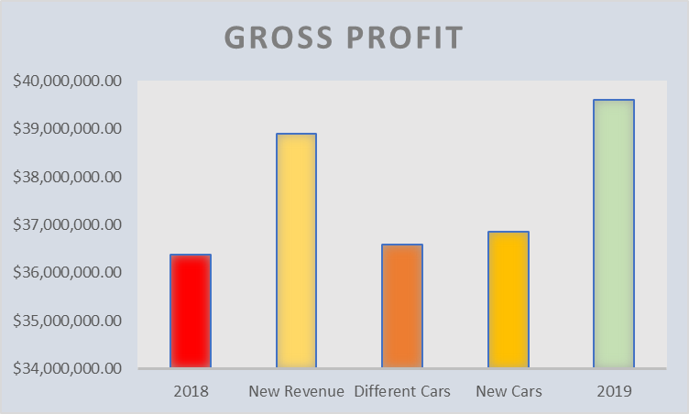
Conclusion
2019 Profit: $39,598,147
Percent Increase: 9%
Combine the three strategies.
Notes:
Here we can see the combined effects of all three strategies we’ve discussed. The projected profits are almost three and a quarter Million dollars above the previous year. Any questions?

Slide 12
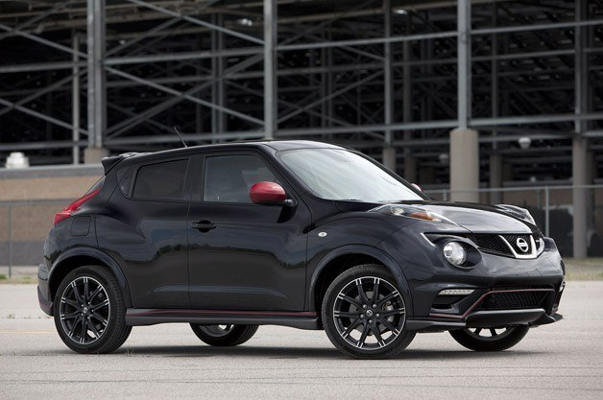

The End
Link to
Flyer:
https://drive.google.com/file/d/160eMUDGxL4XvOQ69xIuaAbmmUpedhDgC/view?usp=sharing
This Photo by Unknown Author is licensed under CC BY-NC
Notes:
And this is my car. You find a link to the flyer I mentioned earlier at the bottom of the screen. Thanks for joining

